Slide 1



ENVIRONMENTAL IMAPCT ASSESMENT
Presented by-
SOURAV KR JAISWAL

Slide 2

Environmental Impact Assessment (EIA)
Environmental Impact Assessment (EIA) is defined as, “An activity designed to identify, predict, interpret and communicate information about the impact of an action on man’s health and well-being (including the well-being of ecosystems on which man’s survival depends).

Slide 3

Objectives of EIA
To identify and describe the Environmental Resources or the environmental Attributes (EA) which will be affected by the proposed project, under existing or “with or without project” conditions.
To describe the alternatives to the proposed project which could accomplish the same result but with a different set of environmental effects.

Slide 4


HISTORY OF EIA IN INDIA
Started in 1976-77, when Planning Commission asked Department of Science & Technology to examine River Valley Projects from environmental angle.
EIA was first introduced in 1978 with regard to the various river valley projects all over the country and later expanded to include various other developmental procedures in its scope. EIA is now mandatory for over 30 classes of projects.

Slide 5

PROCESS OF EIA
The way in which an EIA is carried-out is not rigid: it is a process comprising a series of steps. These steps are outlined below: 1) Screening 2) Scoping 3) Prediction and mitigation 4) Management and monitoring 5) Audit

Slide 6

Screening
Audit
Monitoring
Scoping
Management
Prediction
Mitigation

Slide 7
Uses of EIA
Systematic evaluation of a eco friendly project
Risk and hazard assessment.
Impact identification.
Monitoring of impact and advice.

Slide 8
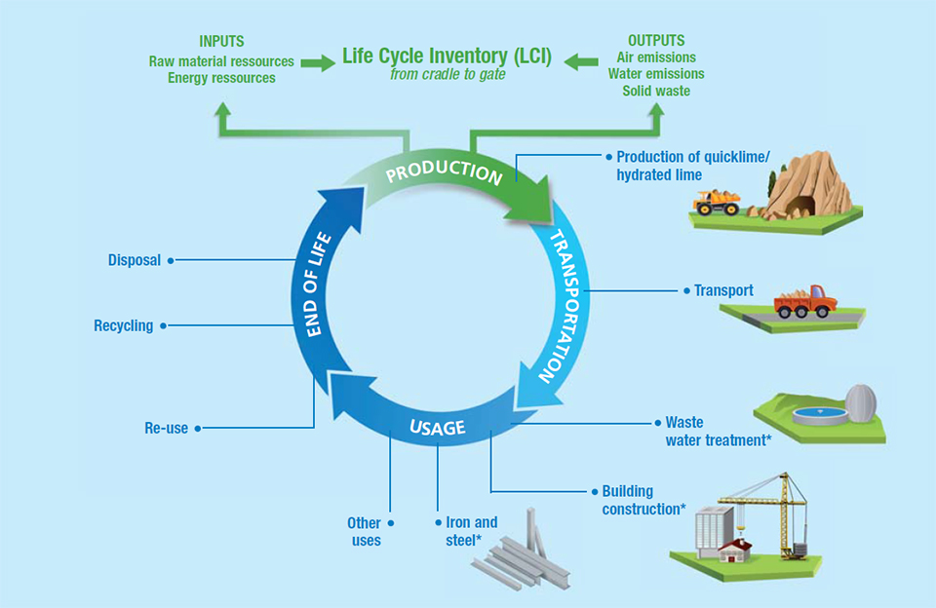

Slide 9
CONCLUSION
EIA is an important tool in assuring that projects and plans will not give adverse impact on the environment.
The use of EIA has developedthroughout the world and may differentapplications exists.
EIA process thus could not only prevent costs due to environmental aspects but also prevent possible public opinions and protest against a project.

